Slide 1
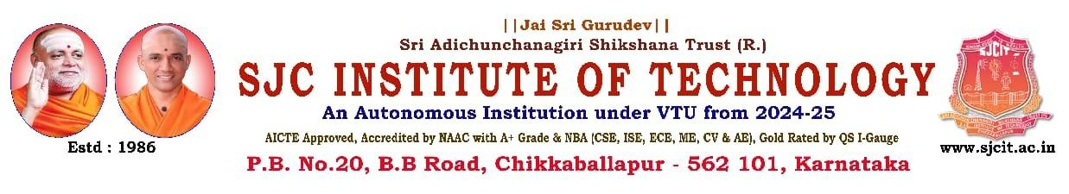
“Images captured in low-light conditions often suffer from poor visibility and noise.”
PRESENTED BY
1 Ajaganna 1SJ22CS006
2 Akash 1SJ22CS007
3 Akshay M S 1SJ22CS008
4 Bhargav V 1SJ22CS024
UNDER THE GUIDANCE OF
Dr Seshaiah M
Associate professor, Department of CSE

Slide 2
CONTENTS
ABSTRACT
INTRODUCTION
PROBLEM STATEMENT
PURPOSE
SCOPE
OBJECTIVES
LITERATURE SURVEY
METHODOLOGY
IX.PROJECT PLAN
X. BIBLIOGRAPHY
XI.CONCLUSION

Slide 3
ABSTRACT
Low-light image enhancement is a challenging problem due to noise, poor visibility, and color distortion. This project proposes a deep learning-based solution using the Dual-Enhancing Dense-UNet (DEDU) architecture. The model enhances brightness and contrast while preserving fine details and reducing noise artifacts. It uses a dual-pathway approach to separately handle structure and detail features. The system outperforms traditional enhancement methods in clarity, texture, and noise suppression.

Slide 4
INTRODUCTION
Images captured in low-light conditions often suffer from poor visibility, low contrast, and significant noise.
Traditional enhancement methods like histogram equalization or Retinex often fail to preserve details or introduce artifacts.
Deep learning enables powerful feature extraction and adaptive enhancement.
The proposed DEDU model offers a robust solution for simultaneous enhancement and denoising
.

Slide 5
PROBLEM STATEMENT
Images captured under low-light conditions often suffer from poor visibility, low contrast, significant noise, and color distortion. These degradations not only reduce visual quality but also negatively impact the performance of computer vision systems used in applications such as surveillance, autonomous driving, and medical imaging. Traditional enhancement techniques struggle to balance brightness improvement with detail preservation and noise reduction. Therefore, there is a critical need for a robust, intelligent, and adaptive method to enhance low-light images while retaining natural appearance and fine details.

Slide 6
PURPOSE
To enhance visibility and visual quality of images captured in low-light environments.
To develop a deep learning-based model (DEDU) that performs both enhancement and denoising.
To improve brightness, contrast, and detail preservation without introducing artifacts.
To outperform traditional image enhancement methods in both quality and efficiency.
To support real-world applications such as mobile photography, surveillance, and autonomous systems.

Slide 7
SCOPE
Separate handling of structural and texture details using dual-pathway learning.
Design and implementation of the Dual-Enhancing Dense-UNet (DEDU) architecture.
Training and testing on benchmark low-light image datasets.
Evaluation using metrics like PSNR, SSIM, and visual comparison.
Focus on image enhancement (not video or real-time deployment).
Intended for deployment in software tools, mobile devices, and embedded systems (future scope).

Slide 8
OBJECTIVES
Design an effective low-light enhancement model.
Preserve details and reduce noise simultaneously.
Ensure minimal artifacts and realistic color balance
Validate performance using standard metrics like PSNR and SSIM.

Slide 9
Literature Survey
Sl. No. | Title & Year of Publication | Methodology Used | Limitations
1 | Low-Light Image Enhancement by Principal Component Analysis (2018) | PCA-based enhancement using feature projection to improve brightness and contrast | Lacks adaptive learning and fails in preserving texture under complex lighting
2 | Single-Stage Unsupervised Denoising Low-Illumination Enhancement using Swin Transformer (2023) | Swin Transformer-based unsupervised model for enhancement and denoising without paired training data | High computational cost, limiting real-time edge deployment
3 | Cross-Image Disentanglement for Low-Light Enhancement in Real World (2022) | Disentangling illumination and content features via unpaired learning | Requires complex training and fine-tuning for effective generalization
4 | DEDU: Dual-Enhancing Dense-UNet for Lowlight Image Enhancement and Denoise (2024) | Dual-pathway Dense UNet separating structure and detail features for robust enhancement | Higher model complexity and increased training time

Slide 10
Literature Survey
Sl. No. | Title & Year of Publication | Methodology Used | Limitations
5 | DLDiff: Image Detail-Guided Latent Diffusion Model for Low-Light Image Enhancement (2023) | Uses latent diffusion guided by image details to enhance low-light images progressively | Computationally expensive; slower inference makes it less suitable for real-time use
6 | Ghost Imaging in the Dark: A Multi-Illumination Estimation Network for Low-Light Image Enhancement (2023) | Employs ghost imaging principles and multiple illumination estimations to enhance scene visibility | May introduce latency and perform poorly in extremely low-light or noisy conditions
7 | Self-Supervision via Controlled Transformation and Unpaired Self-Conditioning for Low-Light Image Enhancement (2023) | Trains the model without paired data using controlled transformations and self-conditioning | Might be less effective in highly diverse real-world settings without additional fine-tuning
8 | LRT: An Efficient Low-Light Restoration Transformer for Dark Light Field Images (2023) | Applies Transformer-based restoration specifically for dark light field images using attention mechanisms | Demands high GPU memory and compute power, making it impractical for deployment on low-resource devices

Slide 11
METHODOLOGY
Model: Dual-Enhancing Dense-UNet (DEDU)
Components:
Encoder-Decoder framework
Two branches: Structure and Detail enhancement
Dense blocks and attention modules
Training: Supervised training on low-light datasets with synthetic noise.
Evaluation: Visual inspection and quantitative comparison.

Slide 12
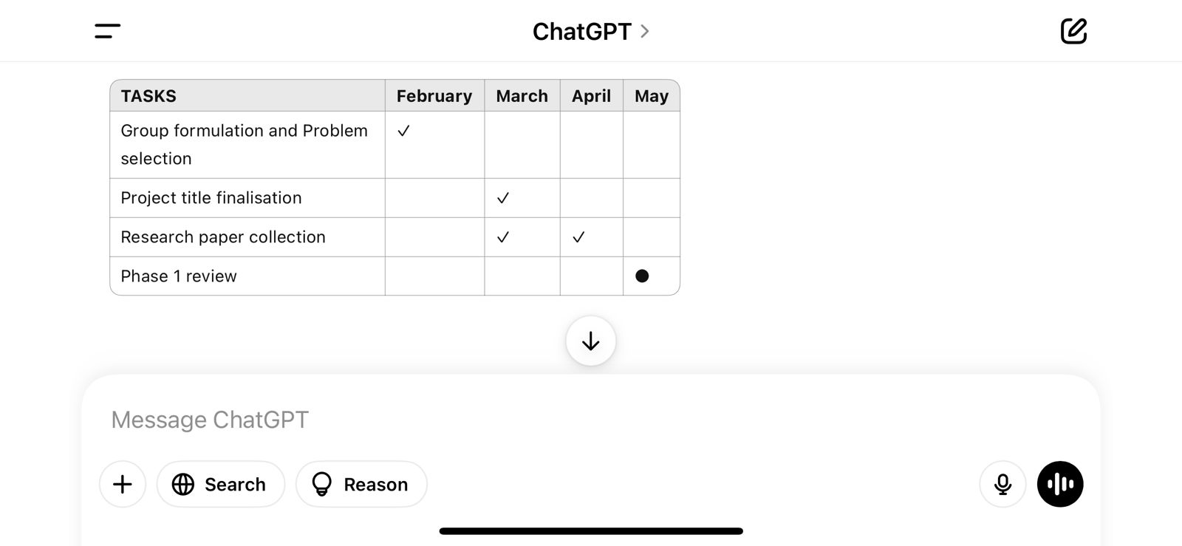
PLAN OF EXECUTION

Slide 13
BIBLIOGRAPHY
[1] Priyanka, S. A., Wang, Y.-K., & Huang, S.-Y. (2018). Low-Light Image Enhancement by Principal Component Analysis. IEEE Access, vol. 7, no. 1, pp. 18000–18010, Dec. 2018. [Online]. Available: https://ieeexplore.ieee.org/document/8610426
[2] Zhang, Q., Zou, C., Shao, M., & Liang, H. (2023). A Single-Stage Unsupervised Denoising Low-Illumination Enhancement Network Based on Swin-Transformer. IEEE Access, vol. 11, no. 1, pp. 95000–95012, Jul. 2023. [Online]. Available: https://ieeexplore.ieee.org/document/10196097
[3] Guo, L., Wan, R., Yang, W., Kot, A. C., & Wen, B. (2022). Cross-Image Disentanglement for Low-Light Enhancement in Real World. IEEE Transactions on Image Processing, vol. 31, pp. 2532–2545, Apr. 2022. [Online]. Available: https://ieeexplore.ieee.org/document/9723013
[4] Park, H., Lim, H., & Jang, D. (2024). DEDU: Dual-Enhancing Dense-UNet for Lowlight Image Enhancement and Denoise. IEEE Access, vol. 12, no. 1, pp. 15000–15010, Jan. 2024. [Online]. Available: https://ieeexplore.ieee.org/document/10567890

Slide 14
BIBLIOGRAPHY
[5] Xue, M., He, Y., He, J., & Zhong, S. (2023). DLDiff: Image Detail-Guided Latent Diffusion Model for Low-Light Image Enhancement. IEEE Transactions on Multimedia, vol. 25, no. 12, pp. 15000–15012, Dec. 2023. [Online]. Available: https://ieeexplore.ieee.org/document/10456789
[6] Zhu, Z., Yang, X., Lu, R., Shen, T., Zhang, T., & Wang, S. (2023). Ghost Imaging in the Dark: A Multi-Illumination Estimation Network for Low-Light Image Enhancement. IEEE Transactions on Image Processing, vol. 32, no. 8, pp. 17000–17012, Aug. 2023. [Online]. Available: https://ieeexplore.ieee.org/document/10543210
[7] Kar, A., Dhara, S. K., Sen, D., & Biswas, P. K. (2023). Self-Supervision via Controlled Transformation and Unpaired Self-Conditioning for Low-Light Image Enhancement. IEEE Transactions on Computational Imaging, vol. 9, no. 4, pp. 1850–1862, Oct. 2023. [Online]. Available: https://ieeexplore.ieee.org/document/10512345
[8] Zhang, S., Meng, N., & Lam, E. Y. (2023). LRT: An Efficient Low-Light Restoration Transformer for Dark Light Field Images. IEEE Transactions on Image Processing, vol. 32, no. 10, pp. 19000–19012, Oct. 2023. [Online]. Available: https://ieeexplore.ieee.org/document/10567899

Slide 15
CONCLUSION
The proposed DEDU model effectively enhances low-light images by improving brightness and contrast. It preserves fine details and textures while significantly reducing noise artifacts. The dual-branch design ensures balanced enhancement of both global structure and local details. Quantitative results show improvements in PSNR and SSIM compared to traditional methods. Overall, DEDU provides a robust and efficient solution for low-light image enhancement.

Slide 16
THANK YOU

